Slide 1

Tandem repeat expansions in frontotemporal dementia
Wouter De Coster
Postdoc, software developer
Content warning: unitalicized gene names, Pooh

Slide 2
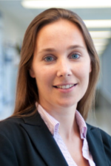
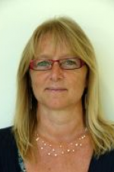
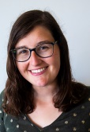
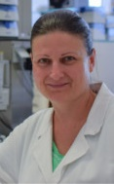
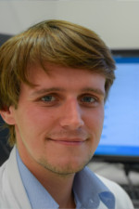
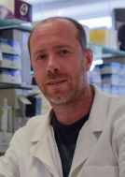
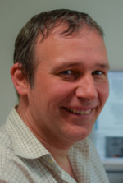
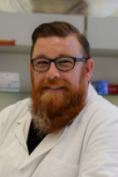
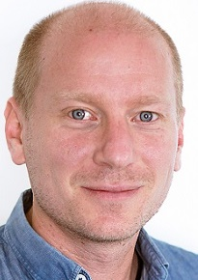
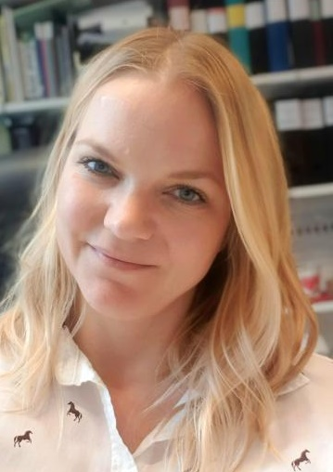
Acknowledgments
Applied and Translational Neurogenomics Group Rosa Rademakers Marleen Van den Broeck Sarah Wynants Inge Bruggeman
Neuromics Support Facility Mojca Strazisar
Svenn D'Hert Tim De Pooter Peter De Rijk Geert Joris
SciLifeLab, Uppsala University Adam Ameur
Ida Hoijer

Slide 3
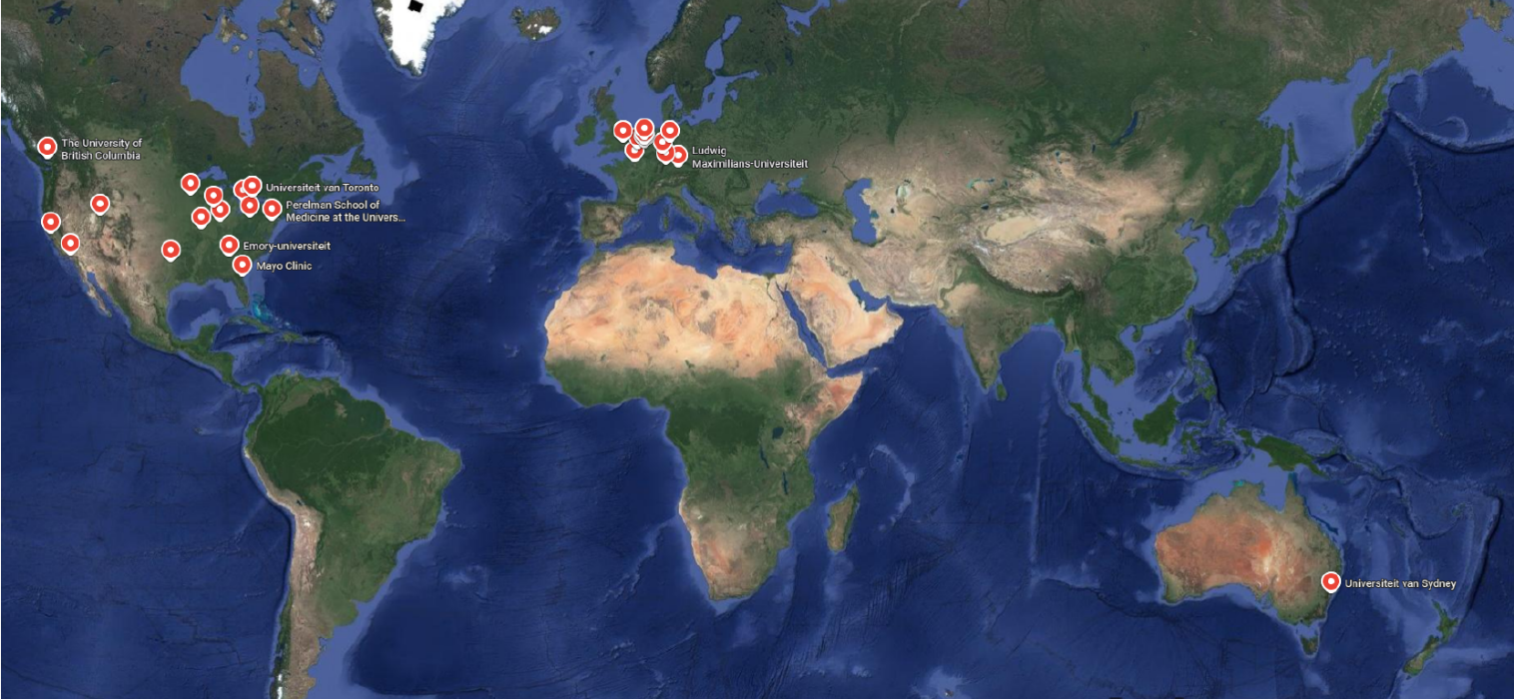






































Acknowledgements - Collaborators
Born Bunge Institute |  |  | Northwestern University
Anne Sieben | Patrick Cras |  | Margaret Flanagan | Rudolph Castellani
Sebastiaan Engelborghs | Bart De Vil |  | Tamar Gefen | Allegra S. Kawle
Emory University |  |  | Marsel M. Mesulam | Sandra Weintraub
Marla Gearing | Jonathan Glass |  | University of Pennsylvania
Erasmus Medical Center |  |  | Vivianna Van Deerlin | Edward B. Lee
John C. Van Swieten | Harro Seelaar |  | David J. Irwin | EunRan Suh
Merel O. Mol | Jeroen GJ. van Rooij |  | University College London
French Collaboration |  |  | Jonathan D. Rohrer | Tammaryn Lashley
David Wallon | Serge Belliard |  | Natalie L. Woodman
Florent Marguet | Gaël Nicolas |  | University of British Columbia
Florence Lebert | Florence Pasquier |  | Ian RA. Mackenzie | Trevor Hurwitz
Vincent Deramecourt | Susana Boluda |  | University of California, San Francisco
German Center for Neurodegenerative Diseases |  |  | William W. Seeley | Bruce L. Miller
Manuela Neumann |  |  | Lea T. Grinberg | Salvatore Spina
Indiana University |  |  | Howard J. Rosen | Adam L. Boxer
Bernardino Ghetti |  |  | Alissa L. Nana
Johannes Gutenberg-Universität |  |  | University of Pittsburgh
Dorothee Dormann | Saskia Hutten |  | Julia Kofler | Oscar L. Lopez
King's College London |  |  | University of Southern California
Claire Troakes | Istvan Bodi |  | Annie Hiniker | Robert A. Rissman
Andrew King | Safa Al-Sarraj |  | University of Sydney
KU Leuven |  |  | Glenda M. Halliday
Rik Vandenberghe | Dietmar R. Thal |  | University of Texas Southwestern
Mathieu Vandenbulcke | Jolien Schaeverbeke |  | Charles L. White, III
Ludwig-Maximilians-University of Munich |  |  | University of Toronto
Sigrun Roeber | Jochen Herms |  | Gabor G. Kovacs | Maria C. Tartaglia
Mayo Clinic Jacksonville |  |  | Shelley L. Forrest
Dennis W. Dickson | Neill R. Graff-Radford |  | University of Utah
Nikhil B. Ghayal | Melissa E. Murray |  | Qinwen Mao
NiCole A. Finch | Matt Baker |  | University of Western Ontario
Mariely DeJesus-Hernandez | Marka van Blitterswijk |  | Elizabeth C. Finger | Lee-Cyn Ang
Mayo Clinic Rochester |  |  | VIB-UAntwerp CMN
Bradley F. Boeve | Ronald C. Petersen |  | Kristel Sleegers | Fahri Küçükali
Keith A. Josephs | Joanna M. Biernacka |  | Mojca Strazisar | Svenn D'Hert
Anthony Batzler | Aivi T. Nguyen |  | Peter De Rijk | Geert Joris
Reichard R. Ross |  |  | Tim De Pooter

Slide 4
Pathogenic tandem repeats

Slide 5
pathSTR: database and visualization
Genotypes of pathogenic STRs from long-read genomes https://pathstr.bioinf.be/
>1000 individuals from nanopore sequencing of the 1000 Genomes Project
(Noyvert et al. 2023, Schloissnig et al. 2024, Gustafson et al. 2024)
STRdust: tandem repeat genotyper for long-read sequencing
github.com/wdecoster/STRdust

Slide 6
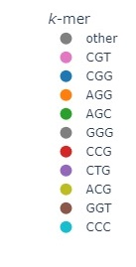
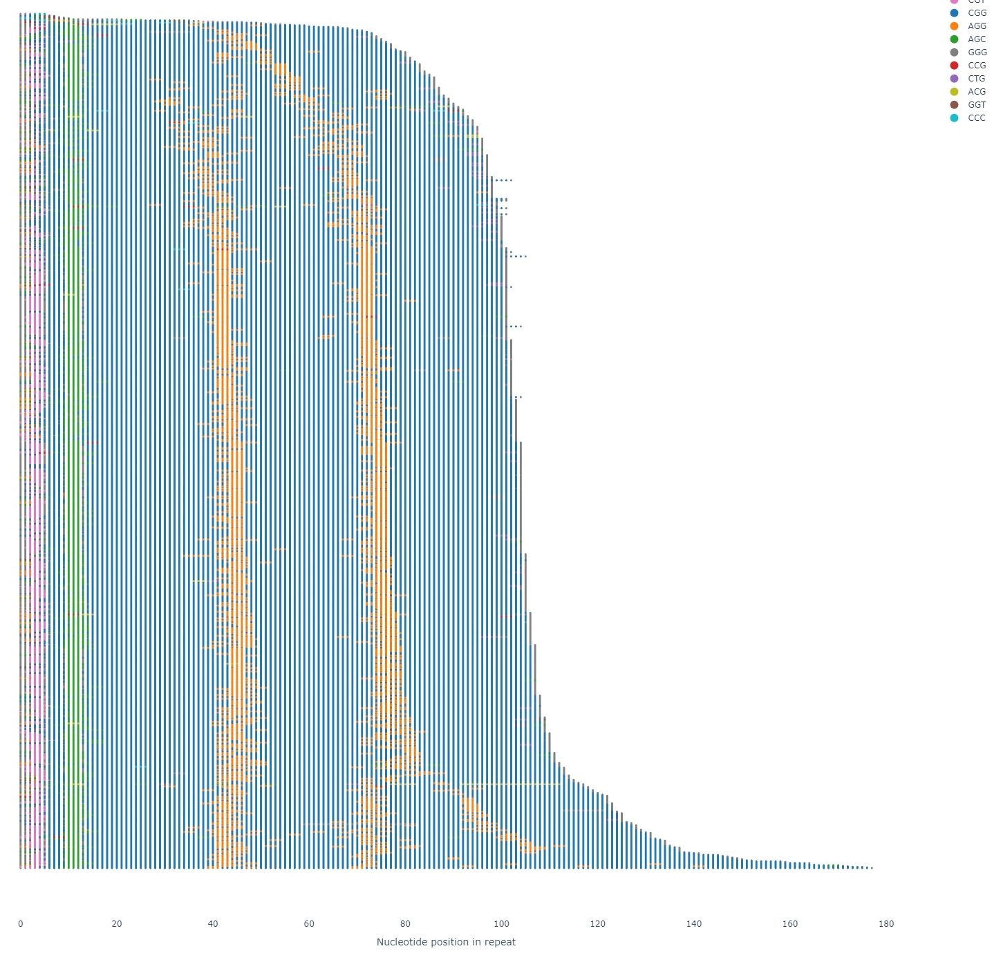
pathSTR
Looking at FMR1 repeat sequence
(aSTRonaut)
Periodic AGG interruptions

Slide 7
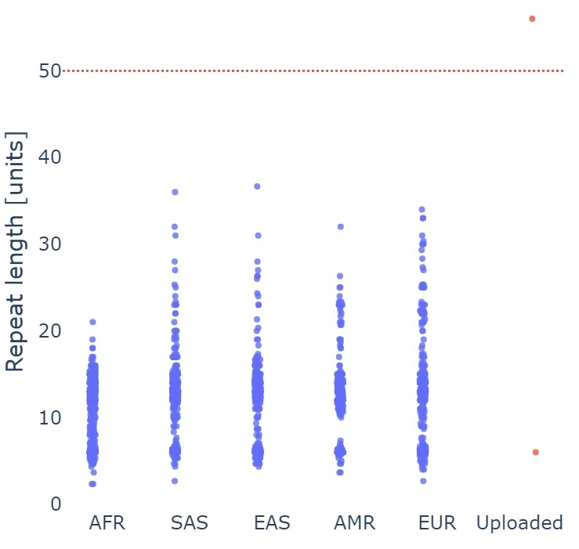
pathSTR
Pathogenic length cutoff
Upload STR genotypes from patient with myotonic dystrophy
Cas9-capture sequencing of the DM1 repeat
(Uppsala, Sweden)

Slide 8
In-house data Frontotemporal dementia

Slide 9
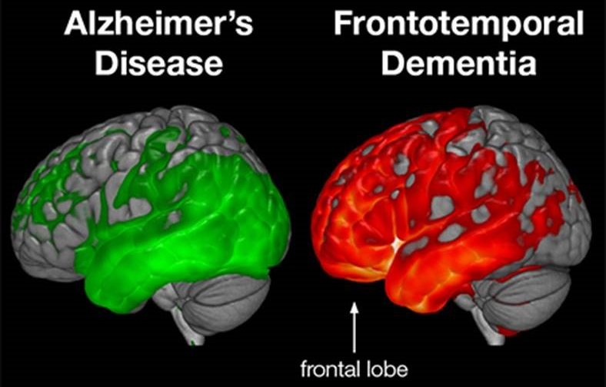
In-house data
>350 brain genomes sequenced from patients and control individuals
Subtype of dementia: language or behavioral impairment

Slide 10

Pathological subtypes
FTLD-FET
FTLD-TDP
FTLD-Tau

Slide 11
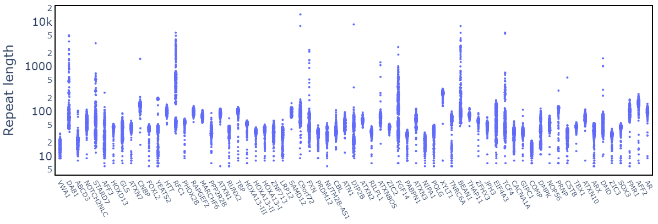
Genotyping those pathogenic STRs

Slide 12
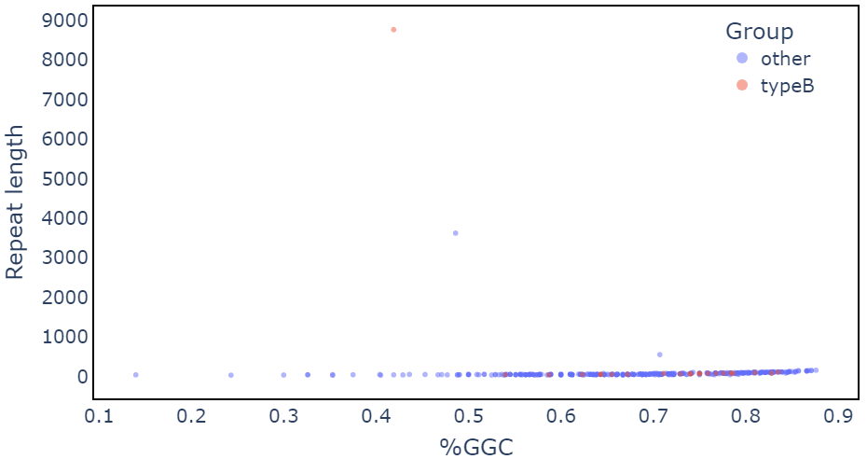
Outlier analysis with 1000 Genomes data
Woooooooop

Slide 13
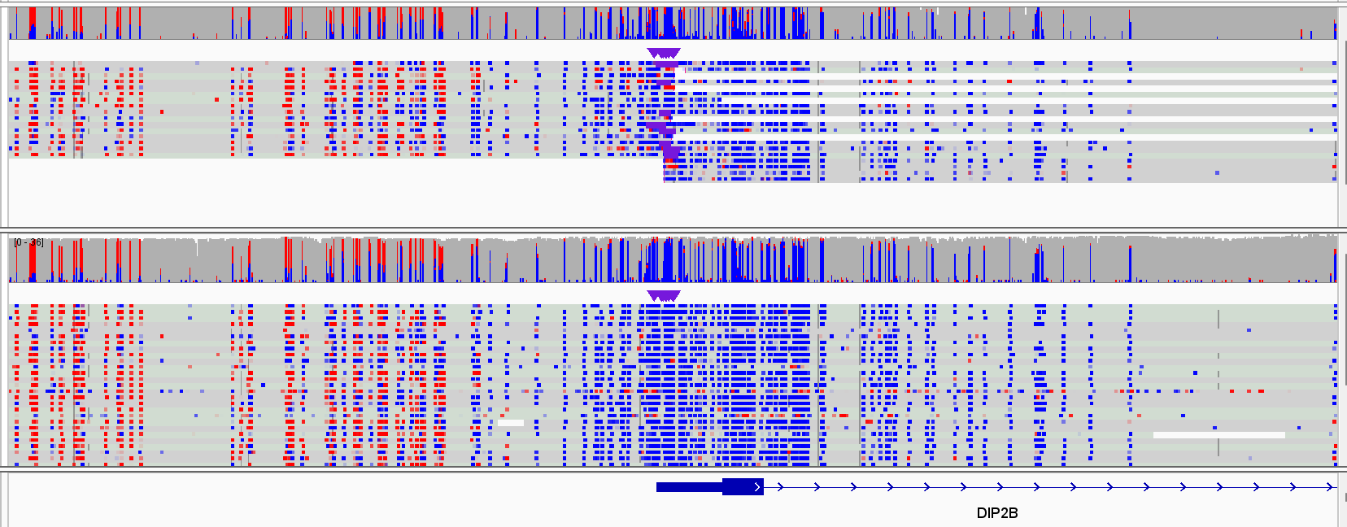
No hypermethylation at DIP2B expansion
DIP2B expansion carrier
Control individual

Slide 14
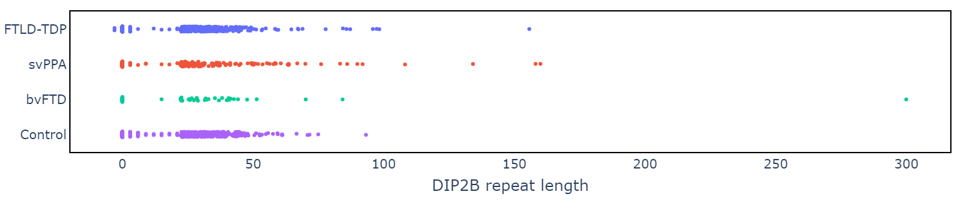
Check short-read sequencing data
Length is likely underestimated

Slide 15
Let’s talk about the pig

Slide 16
Pathological subtypes
FTLD-FET
FTLD-TDP
FTLD-Tau

Slide 17
FTLD-FET essentials
Protein aggregates contain FUS, EWS, TAF15
~10% of FTD patients
aFTLD-U subsubtype
Early-onset behavioral variant FTD
No family history
Rare : collected ~100 patients with autopsy

Slide 18
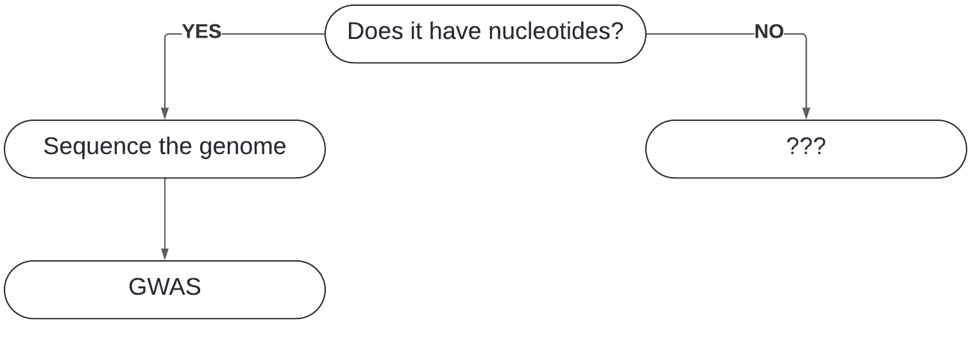
Universal genetics approach
Short-read genome sequencing
59 aFTLD-U patients
~3000 control individuals

Slide 19
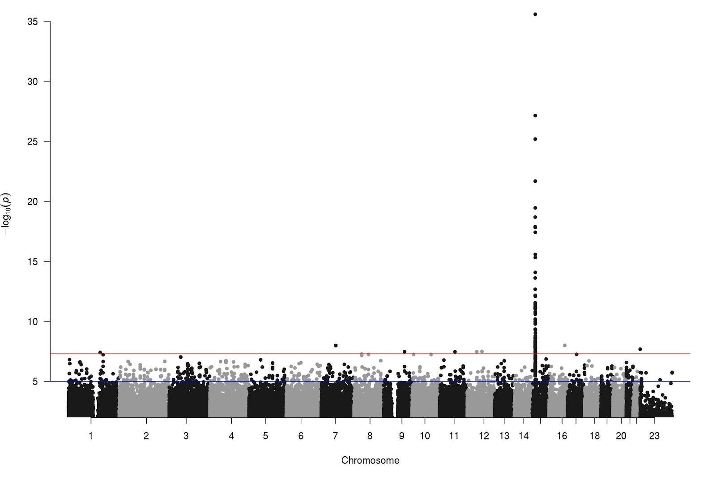
TTTTT>TTTT
45% of patients
1.3% of controls
Whoa
Conditional analysis:
Independent signal in locus
An extra 15% of patients
chr15q14

Slide 20
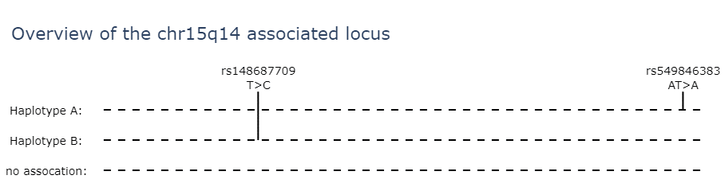

Slide 21
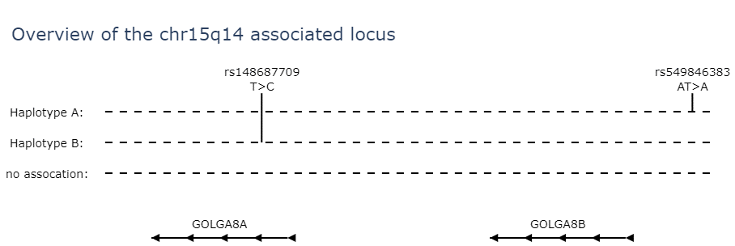

Slide 22
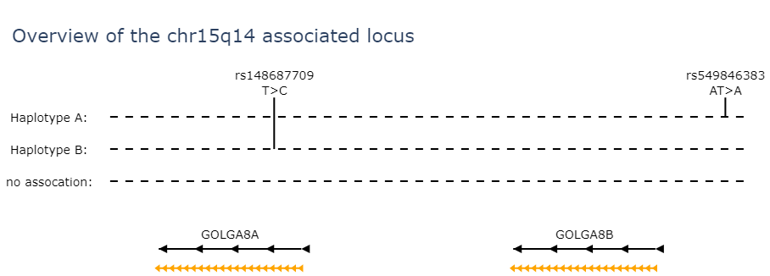
segmental duplications
60kb, >99.8% identical

Slide 23
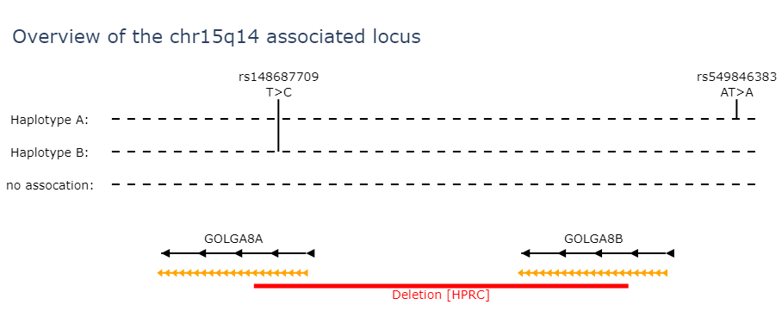

Slide 24
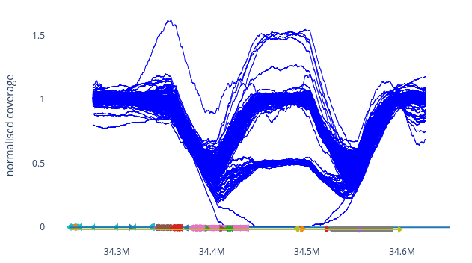

Slide 25

Error in GRCh38

Slide 26


Slide 27
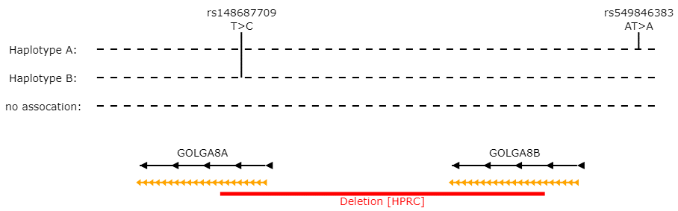
Long reads to the rescue
A repeat expansion!

Slide 28
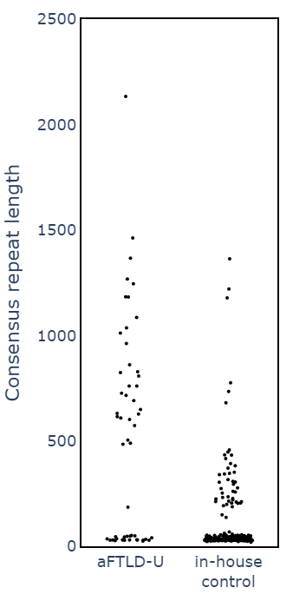
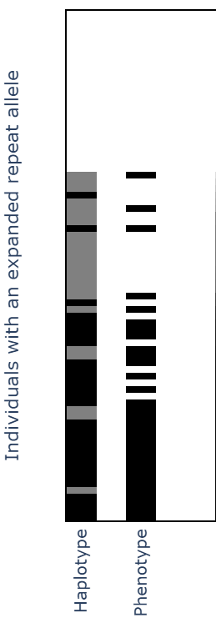
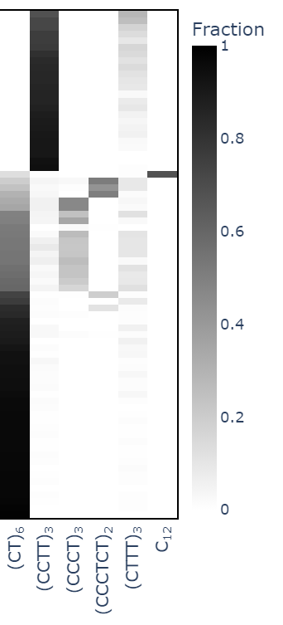

Slide 29
Haplotype A carriers vs. repeat expansion
Long CT-rich expansion
aFTLD-U patients: 38/38
Controls individuals: 16/31 p < 0.00001
(Short expansion, hexamer expansion, or region deleted)

Slide 30
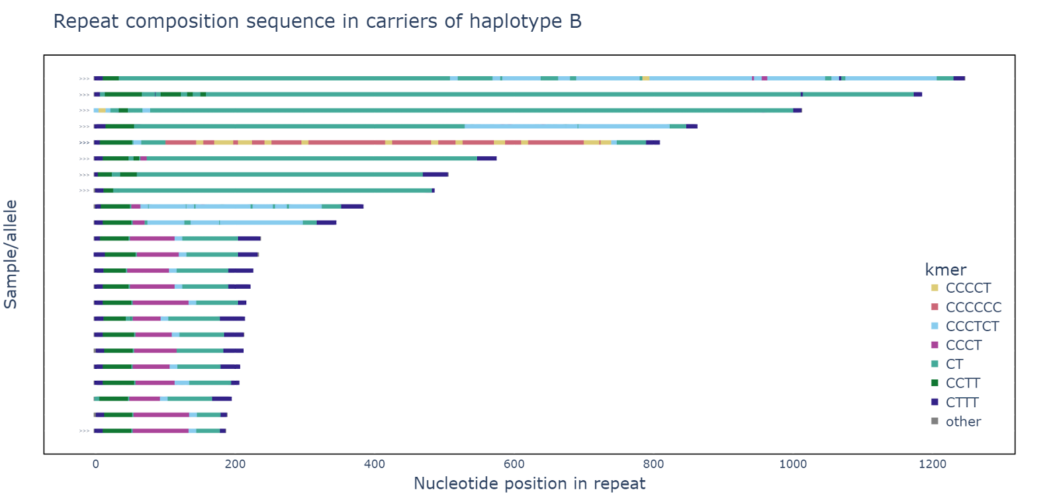

Slide 31
Open questions
Why do some expansion carriers get sick, and others do not?
Why is this disease not segregating in families?
How does this expansion lead to aFTLD-U?
What do the other aFTLD-U patients have?

Slide 32

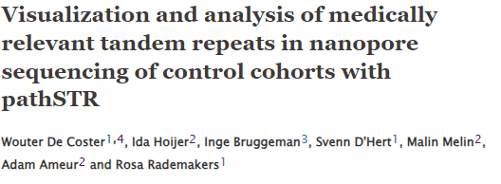
Summary
PathSTR tandem repeat database https://pathstr.bioinf.be/
Identify rare expanded alleles in DIP2B for FTLD-TDP
Identify a repeat expansion in GOLGA8A in 60% of aFTLD-U patients

Slide 33
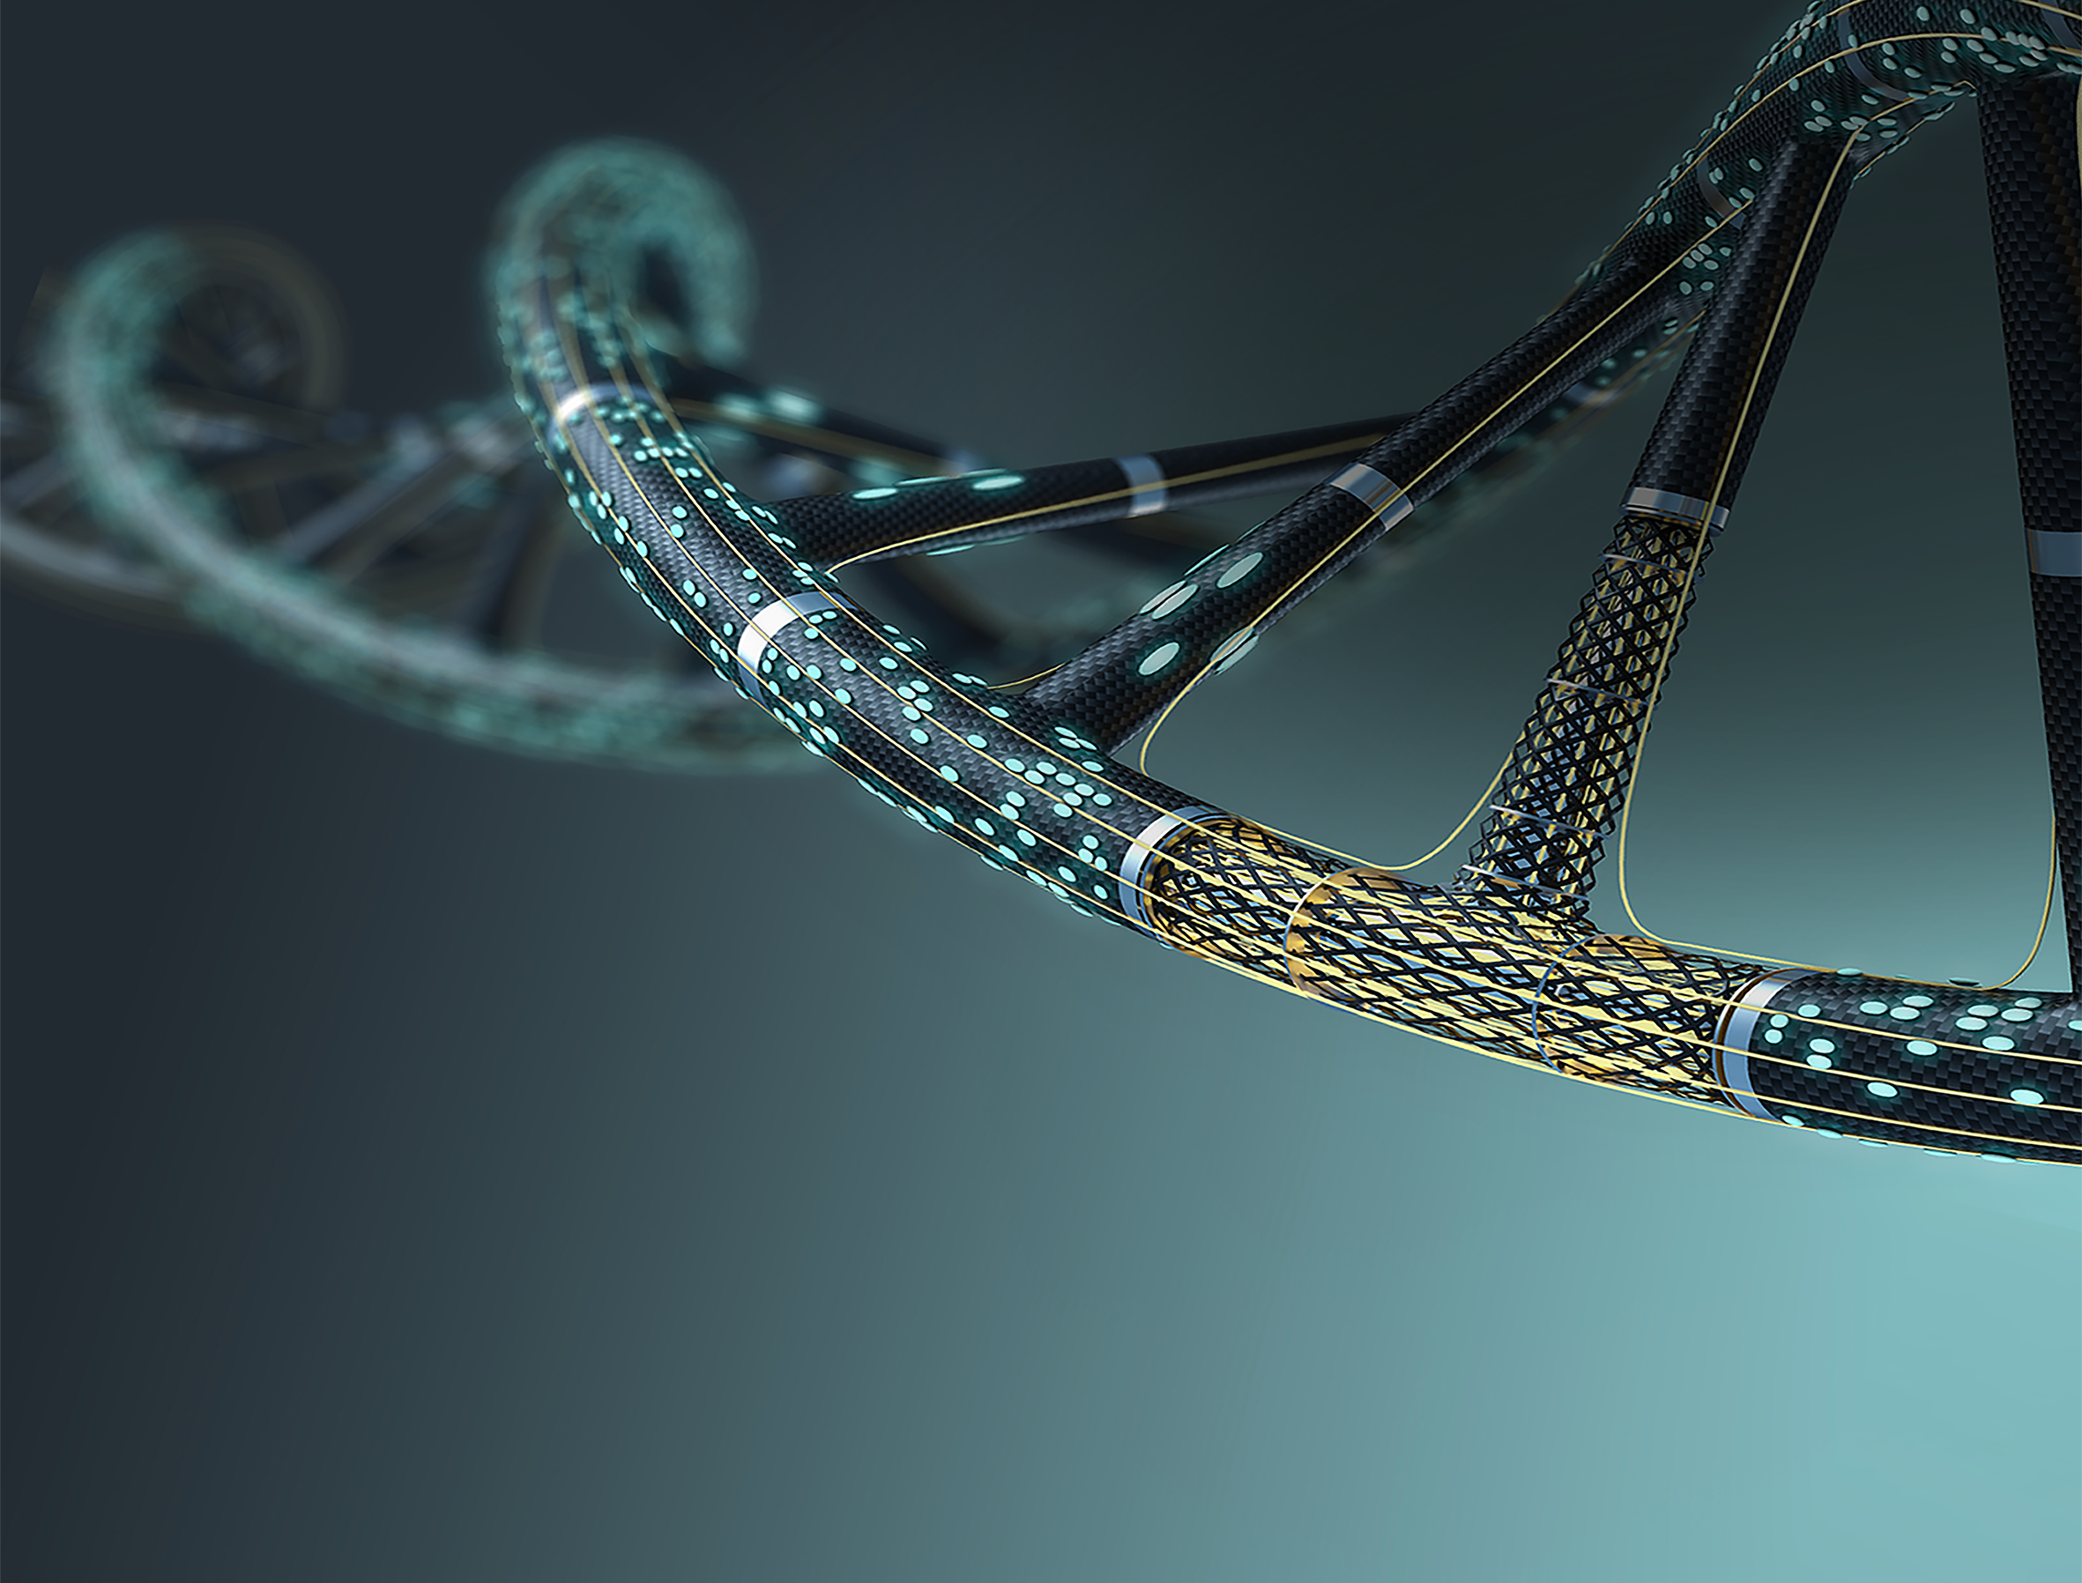


Speakers:
Rocío Acuña Hidalgo, DE
Kirsten Bos, DE
Jeroen de Ridder, NL
Gang Fang, US
Molly He, US
Alexander Hoischen, NL
Masahito Hosokawa, JP
Lorenz Kretschmer, UK
Christopher Mason, US
Todd Michael, US
John Morris, US
Tatsuya Nobori, US
Olga Pettersson, SE
Ana Pombo, DE
Yujia Qing, UK
Rosa Rademakers, BE
Helen Ray-Jones, BE
Fritz Sedlazeck,US
Oliver Stegle, DE
6th edition Revolutionizing
Next-Generation Sequencing
19-21 March 2025, Antwerp, BE
A VIB Tools & Technologies conference
www.vibconferences.be #RNGS25
Upcoming deadlines:
20 Dec 2024 - Travel Grant
15 Jan 2025 - Abstract
05 Feb 2025 - Early Bird

Slide 35
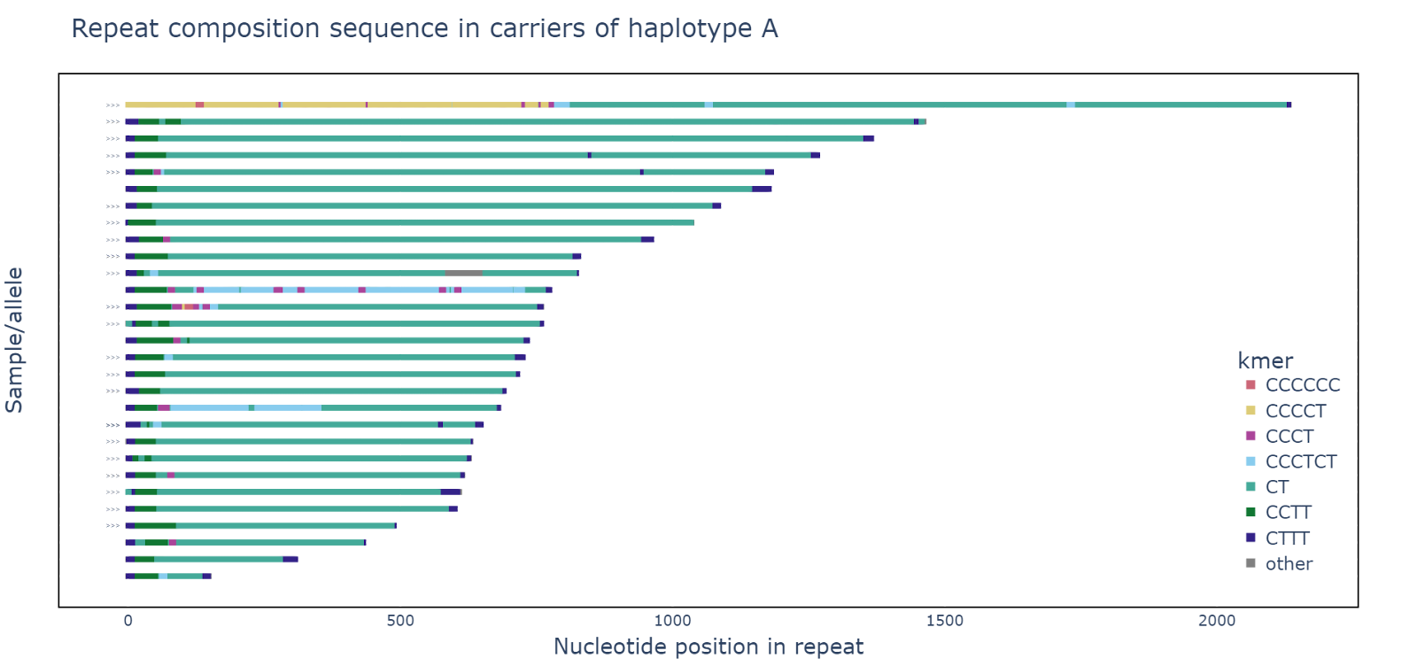

Slide 36
